Slide 2
Vision Statement
Pierson Vocational High School is a student centered option that supports and embraces the diverse needs of students by providing an alternative method of delivering instruction and monitoring academic success. With our rigorous curriculum based on differentiated instruction and technology, intervention programs, extended learning opportunities, competency based learning, and safe school environment are characteristics of Alternative Education Programs.

Slide 3
Alternative High School 2014 Requirements 70% of Students:
1
Students who have a documented history of disruptive behavior issues.
2
Students who have dropped out of school and are now returning.
Students in poor academic standing as demonstrated by being at least one year behind on grade level performance or academic credits.
3
Students who are primary caregivers or are financially responsible for dependents and, therefore, may require a flexible school schedule.
4

Slide 4
January 23, 2015
Congratulations on your accreditation status! AdvancEd/NCA CASI’s Commission met on January 22nd and officially accepted the Arizona schools and districts we had forwarded for accreditation. You have been or soon will be notified with an invitation from our corporate office to access your results in ASSISTTM.
Again, congratulations and we thank you for your leadership in continuing to improve the educational landscape for the students of Arizona.
Respectfully,
Connie Harris, Ed.D.,
Director, AdvancED Arizona Office

Slide 5
“Pierson is a very special place, students feel supported and cared about, parents interviewed confirmed the team’s perceptions of the school.”
“The overall attention given by teachers to the needs of the students, watching teachers work with a wide variety of individual needs while teaching 2 or 3 subjects, brings great respect for the hard work the school and staff are doing.”
“A major challenge for the school is to provide for the wide variety of needs with so few teachers.”

Slide 6
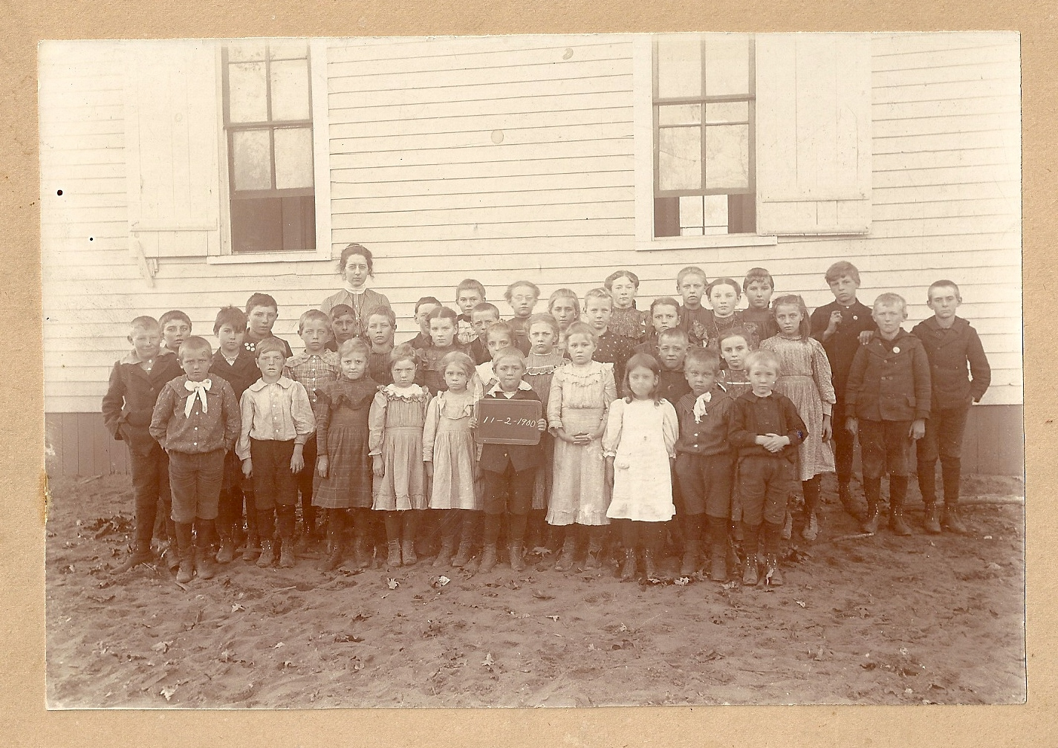
Supportive Learning
Active Learning Environment

Slide 7
Blended Learning/Differentiation
A way of teaching; it asks teachers to know their students well so they can provide each one with experiences and tasks that will improve learning
Understand the differences and similarities among students and use this information to plan instruction, with project based learning, technology, textbooks, workbooks or whatever tool that will be productive.

Slide 8
Competency Based Learning
Allow high schools to get student funding by creating programs that directly measure learning, not time. Students can move at their own pace. The school certifies — measures — what they know and are able to do.

Slide 9
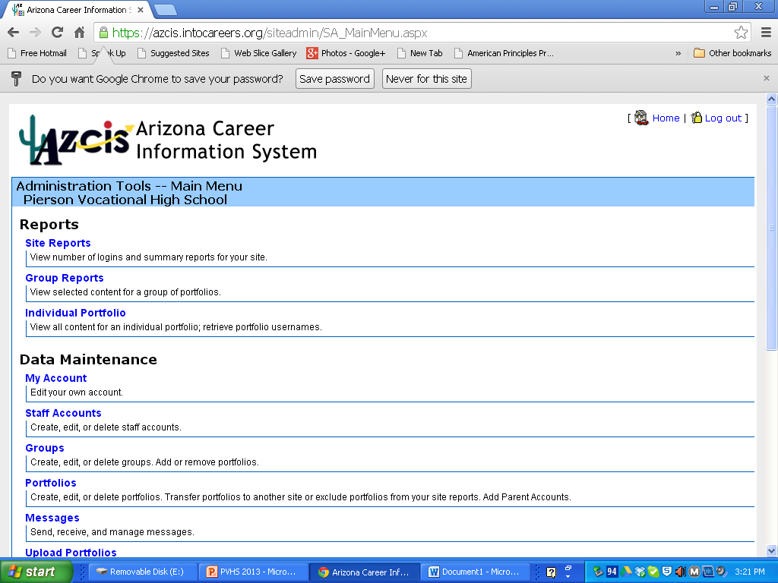

Slide 10
Idea Concept – Professional Memberships With A Willingness to Try New Methods and Stay Current In All Areas that Impact Education.
I
D
E
A

Slide 12
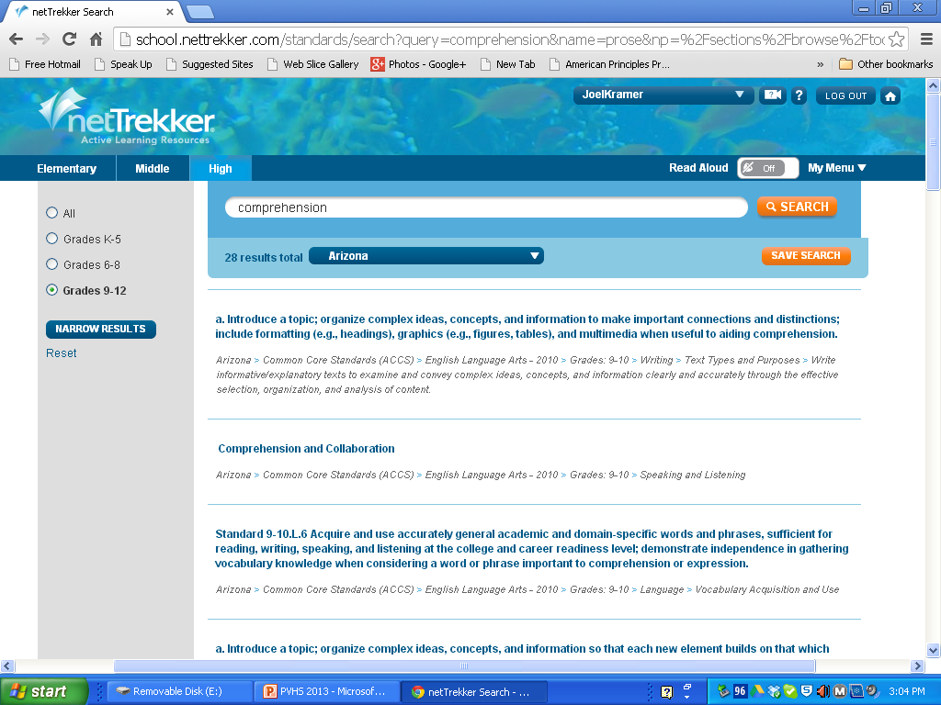

Slide 13
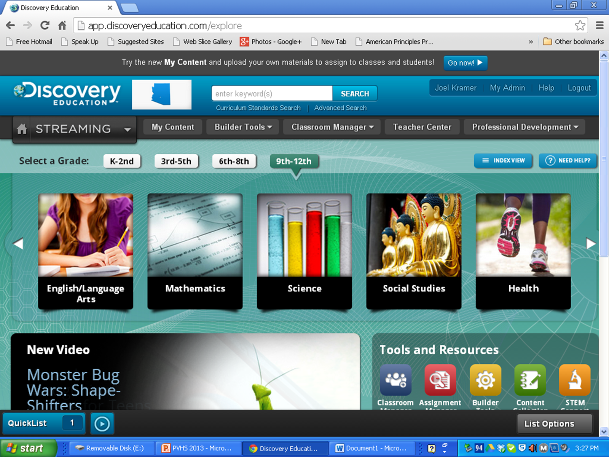

Slide 15
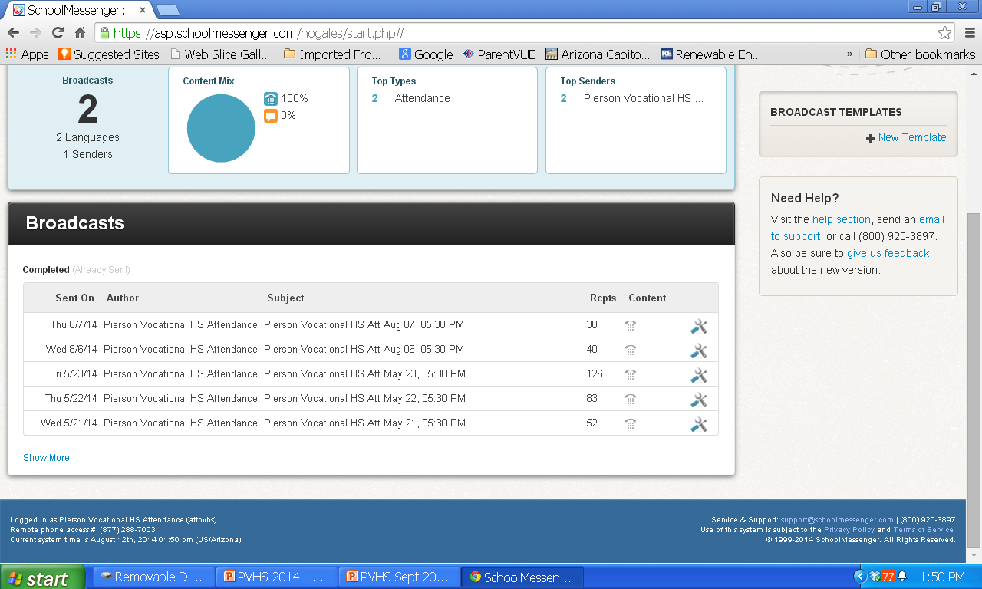

Slide 16
Researching Colleges

Slide 17
English Language Development

Slide 18
English Class

Slide 19
Traditional Learning

Slide 20
98% Free and Reduced
Junior Class 43 Students
Freshman School Year
Algebra 1 Credit 25%
9th Grade English Credit 8%
Sophomores Class 42 Students
19 Passed 8th Reading
13 Passed 8th Math

Slide 21
Pierson Vocational High School was #52 out of 151 Alternative High Schools in Arizona in 2015 #39 in 2014.

Slide 22
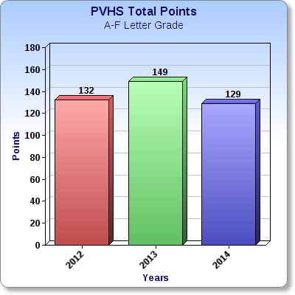
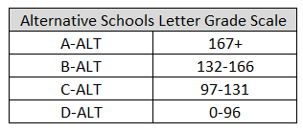

Slide 23
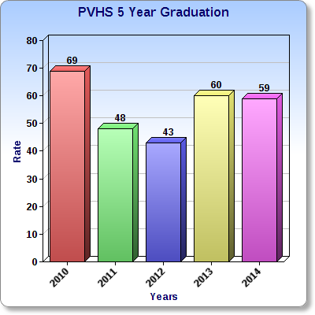

Slide 24
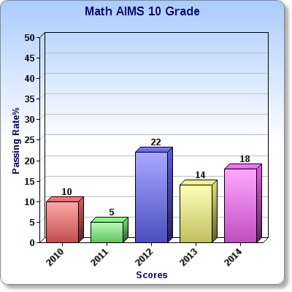

Slide 25
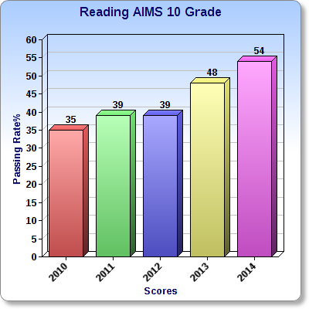

Slide 26
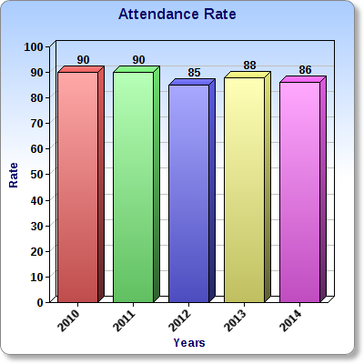

Slide 27
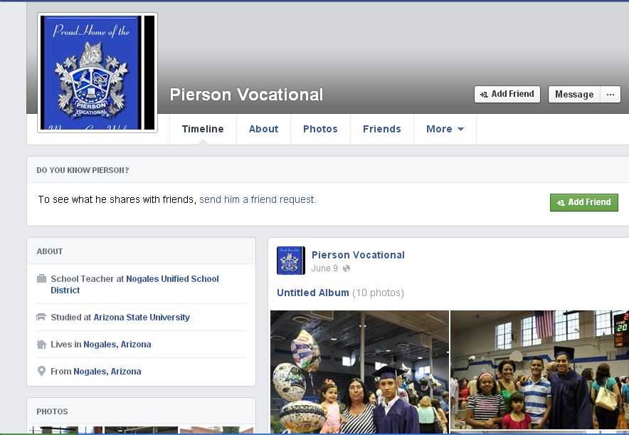
Facebook Page

Slide 28
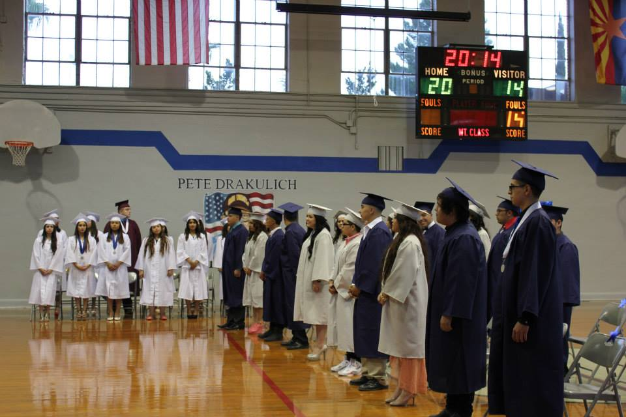
“You have a very special school. You need to let the community know.”
In the Class of 2014 , ½ have enrolled in college - largely due to the efforts of the scholarship program afforded to them by the Mexican Consulate,
S.C. Attorney’s Office and the Shipley Family Trust.

